Slide 1
TEAM RHYTHM ISP:
Blending Music & Code
By: Megha Narumanchi, Ishita Chowdhury & Shariq Hasan

Slide 2
Our Concept
Coding small functions and putting them together to incorporate into the development of music beats and rhythm and pitch which are then used to create music compositions and patterns, through the use of the languages C++ , Ruby, Qt , on the platform Sonic PI!

Slide 3
Learning About Music Composition
Before we started, we wanted to know basic information about music composition so we did some research!
Definition of Music Theory: Defines the elements that form harmony,melody and rhythm.
Elements incorporated into creating musical compositions: tempo, notes, chords, key signatures, scales
Then to add a little flavor to the music….
Dynamics, pitch, tone and textures are also implemented
Notes:
MIDI note values

Slide 4
Learning About Music Composition Cont…
How its all connected!
Harmony: When multiple notes play simultaneously to produce a new sound
Ex. Chords(three or more notes played at the same time), combining vocal parts
Different type of harmonies:
Dissonant: adds notes that don't sound pleasant to the ear when played together
Consonant: notes that sound stable and pleasing to the ear when played together.
Pitch: the audio vibration produced by an instrument or voice. It’s how high or low a note will sound.
Arranging these pitches in a series creates a melody.
Rhythm: the length each pitch will sound. These durations are divided into beat divisions like whole notes, half notes,quarter notes, triplets, etc.

Slide 5
Learning About Music Composition Cont…
CHORD: a group of (typically three or more) notes sounded together, as a basis of harmony.
An arpeggio is a chord broken into a sequence of notes.
Sample: A preexisting recording by someone else in your music

Slide 6
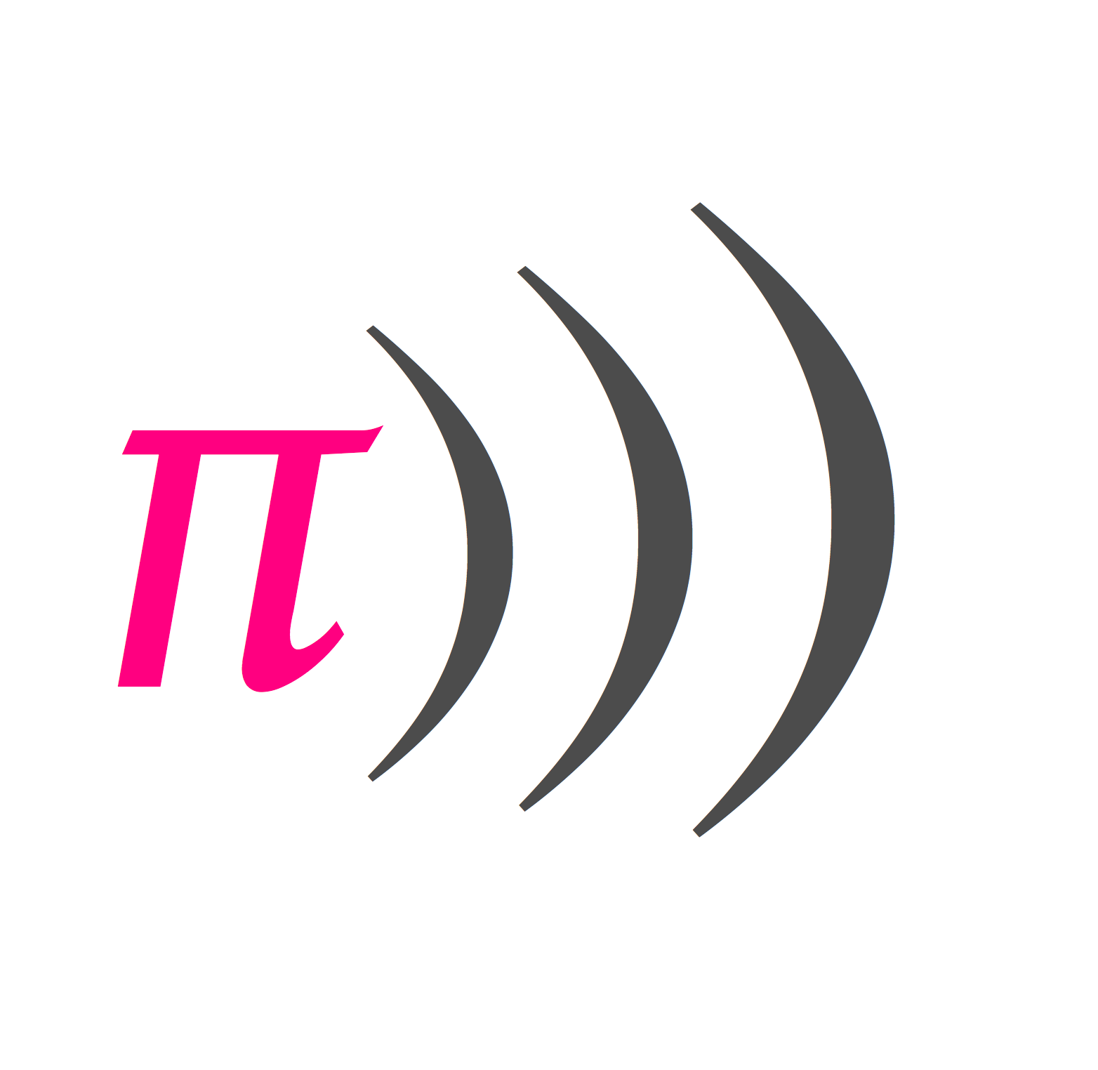
Technology - Sonic Pi
Sonic Pi is an open-source programming environment, designed for creating new sounds with code in a live coding environment
It provides an in-depth tutorial on how to use the programming language, and then provides resources to make your own creations
Using this program, we learned how to:
Loop a tune so that it repeats
How to change the sounds by using different synths and samples
How to play two tunes at the same time using threads
To perform with Sonic Pi by live coding
How to add effects and use parameters to change the way notes sound
How to use randomisation within a composition

Slide 7
LEARNING THE CODE

Slide 8
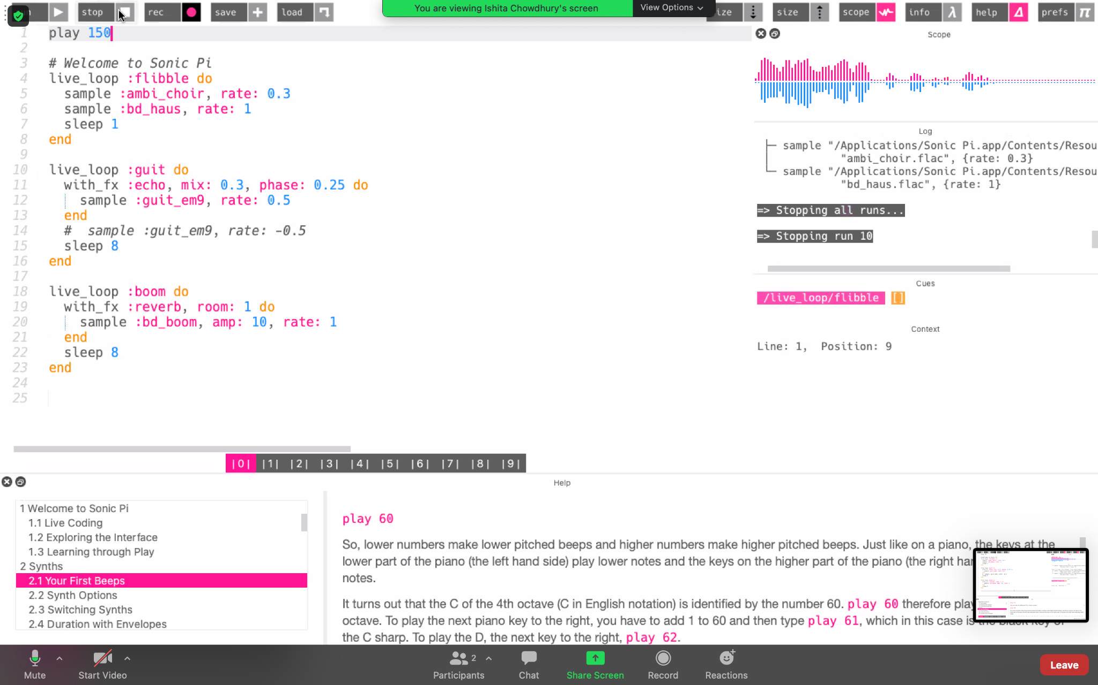
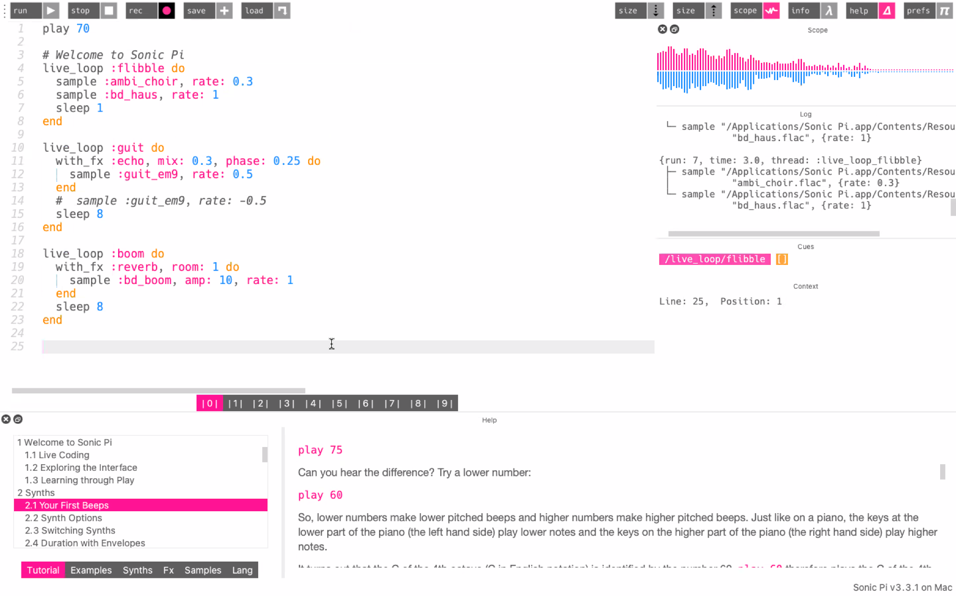

PITCH
Pitch 150
Pitch 70
So, lower numbers make lower pitched beeps and higher numbers make higher pitched beeps. The pitch is controlled by the statement (play #) at the top left of the program.

Slide 9
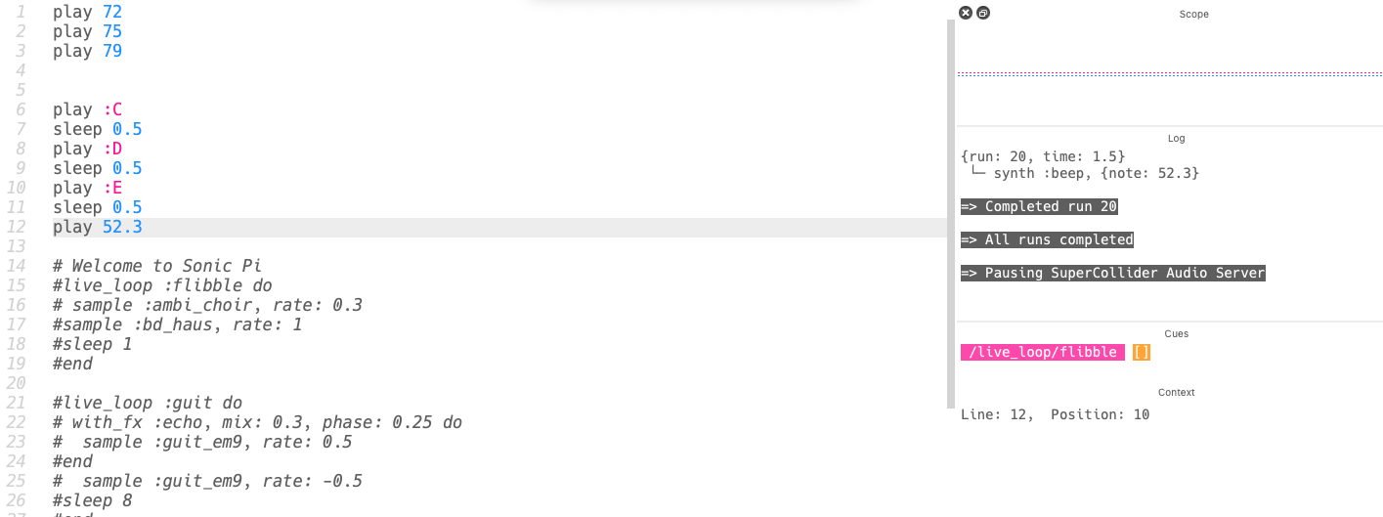
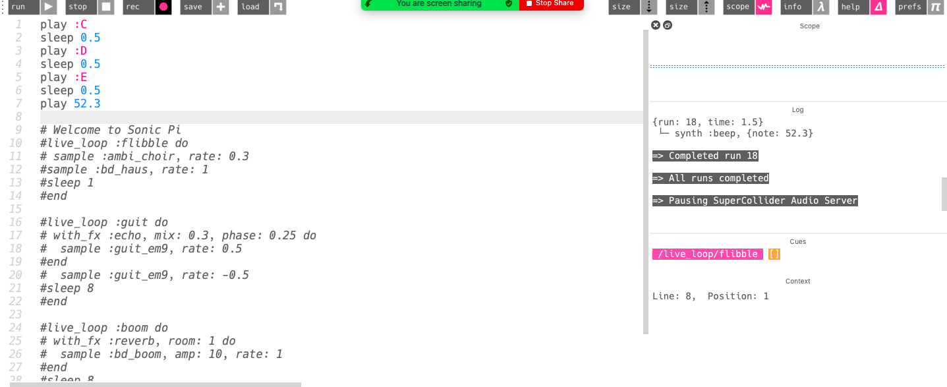
CHORD
Chord
Chord and arpeggio
“Sleep” indicates the pauses in the arpeggio and is measured through beats. You can also assign notes with traditional note names. We made a simple chord progression without adding the sleep beats in.

Slide 10
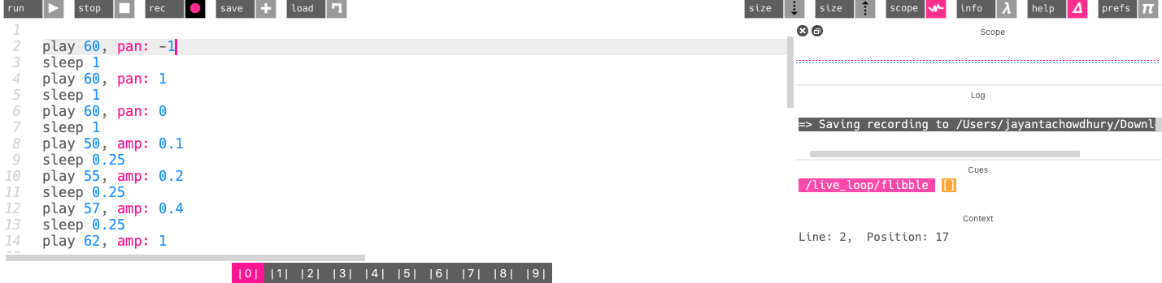
SYNTHS
-Amplitude is a computer representation of the loudness of a sound. Amp: 0.5 will produce a quieter sound than amp: 1
pan: controls the panning of a sound in stereo.
-Synths are capable of generating new sounds depending on how you control them
sse_synth :prophet produces a different sound

Slide 11
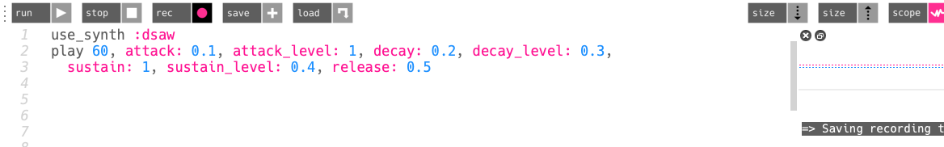
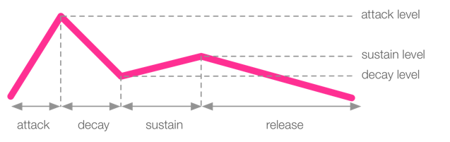
ENVELOPES
ASDR envelopes control over the duration and amplitude of a sound.
attack - move from 0 amplitude to 1 immediately
decay - fits between the attack and sustain phases
sustain - sound is maintained at full amplitude between the attack and release phases
release - time it takes for the synth’s sound to fade out

Slide 12
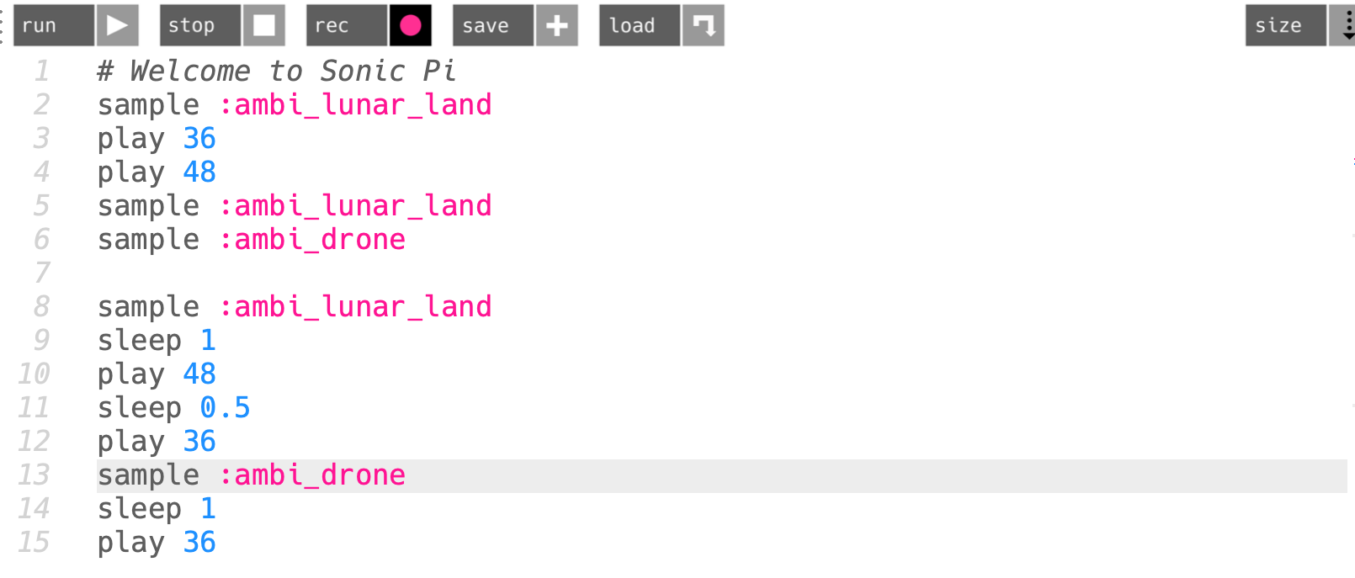
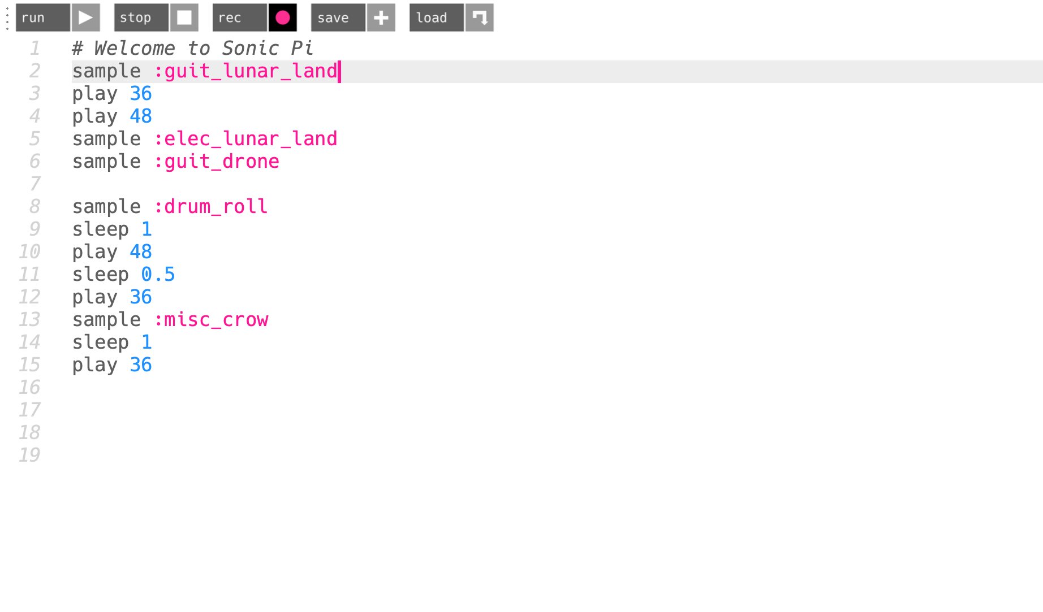
SAMPLES
Ex. of different instruments suffixes
ambi_
:bass_
:elec_
:perc_
:guit_
:drum_
:misc_
:bd_
Samples are pre recorded music bits! You can simply trigger the sample to be played by typing out sample : “sampleSoundName” Multiple samples can be played at the same time by simply listing them one after another. To have spaces in between sounds being triggered a simple sleep “beats #” is to be placed. The listed instrument suffixes correspond to a different instrument thereby altering the sample sound to the correct instrument.

Slide 13
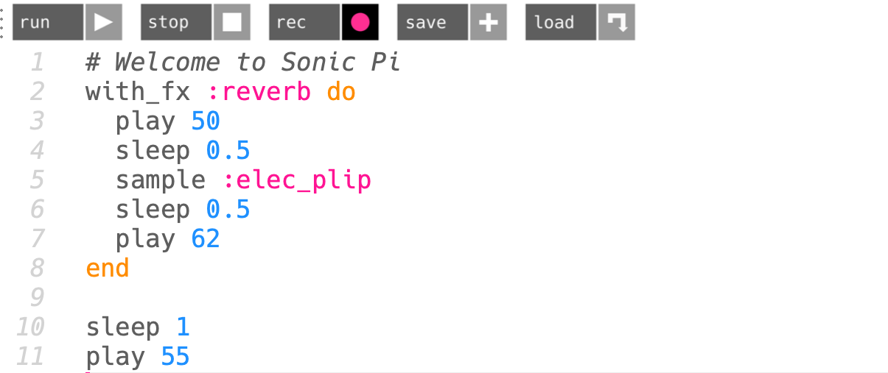
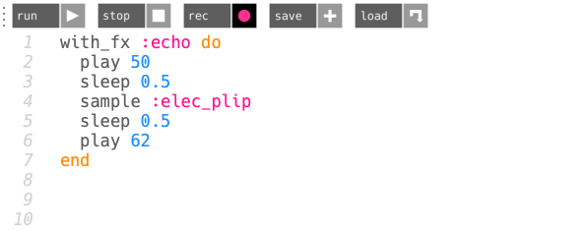
FX: REVERB AND ECHO
The technique reverb allows for music to attain a sense of warmth and rich sound. Reverb can be achieved through the use of the condition “with_fx :reverb”. In the recording the listener can hear the difference between the reverbed portion of code and the portion not affected due to being outside of the reverb condition scope. You can also make the sound echo: with_fx: echo

Slide 14
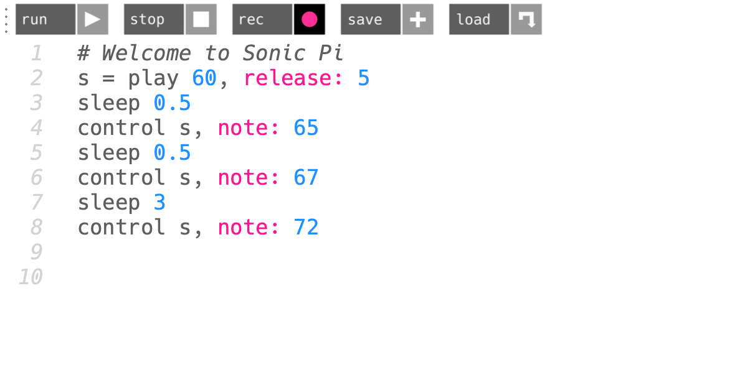
CONTROL
We can now control and modify the sample sounds rather than just triggering them alone. This can be done using the control function. The control function lets us control things like amp: , cutoff: and etc. The S is playing the note 60 and being controlled by the control function.

Slide 15
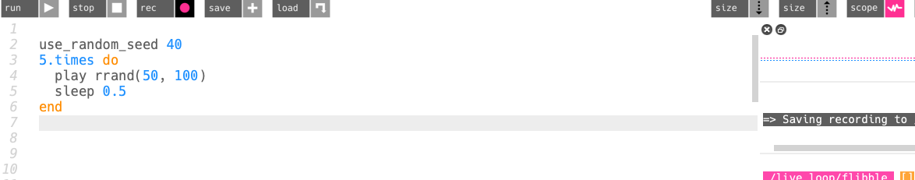
RANDOMIZATION
-This adds randomness to our music
-rrand which will give you a random value between two numbers - a min and a max
-use_random_seed will play a random sequence of a set number of notes and changing the seed will play a different set of random notes
-choose([60, 65, 72]) chooses and item randomly from this array of numbers

Slide 16
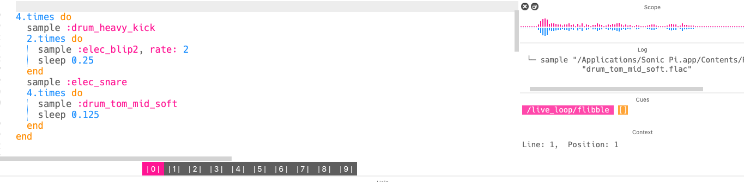
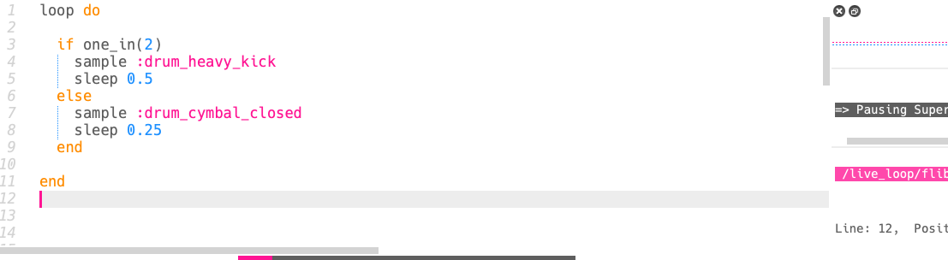
ITERATIONS AND CONDITIONALS
-Iteration allows the code to repeat in a quick and efficient way
-A coin flip is emulated with the one_in function, showing a probability of 1 in 2: one_in(2). -the result of this is used to decide between two pieces of code, for example: the code to play the drum and the code to play the cymbal
*do represents start of function and end represents the end

Slide 17
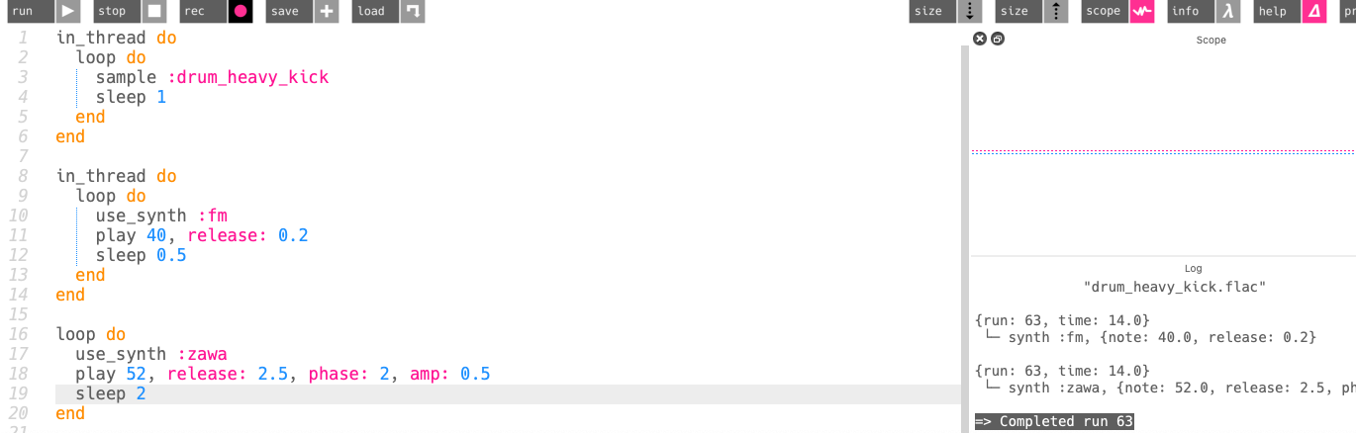
THREAD SYNCHRONIZATION
-threads are used to start something at the same time as the rest of the code.
-in_thread will tell Sonic Pi to run the contents of the do/end block at exactly the same time as the next statement after the block
-threads created with in_thread inherit all of the settings from the parent thread. This includes the current time and means that threads are always in time with each other when started simultaneously.

Slide 18
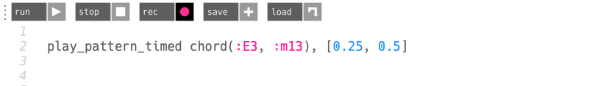
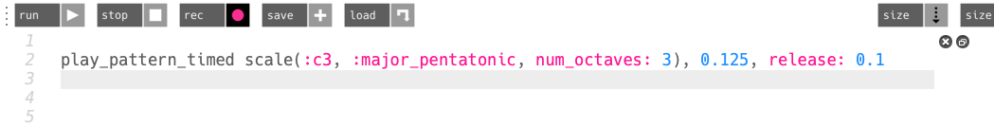
CHORDS AND SCALES AND RINGS
-You can turn chords into arpeggios with the function play_pattern
-You can even play scales with more octaves or a pentatonic scale with play_pattern_timed scale
-A ring is basically an array that automatically starts again when it has reached the last element.

Slide 19
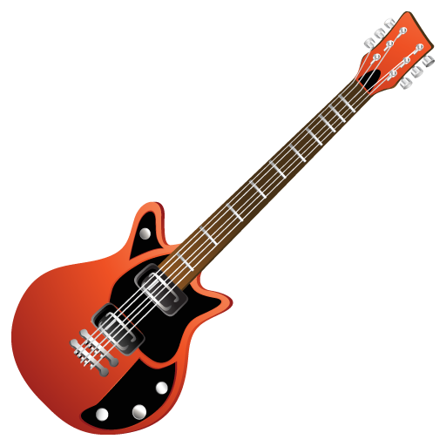
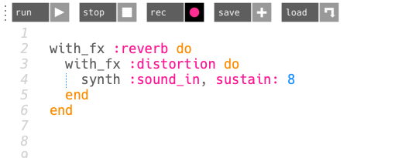
A COOL FEATURE: SOUND IN
-One simple way of accessing sound inputs is using synth by specifying the function
synth :sound_in
-it utilizes analog sounds, such as the in-built microphone in laptops
-for example: you can plug in a guitar and derive sounds from that
-you can also layer on effects using the FX block, such as reverb

Slide 20
MAKING OUR OWN SONG
Notes:
Add live loops and ring and ticking

Slide 21
MOOD OF MUSICAL COMPOSITION
Our first criteria was coming up with a general mood for the song. We wanted it to sound kind of dreamy, with a lot of piano chord progressions. So we decided to search the internet for dreamy chords and came across these:
Chord e,g,d,f,c,d,e major & Chord c,e,a,f,c,d,e minor
These chords served as our base sounds and helped us achieve the vibe for our musical composition

Slide 22
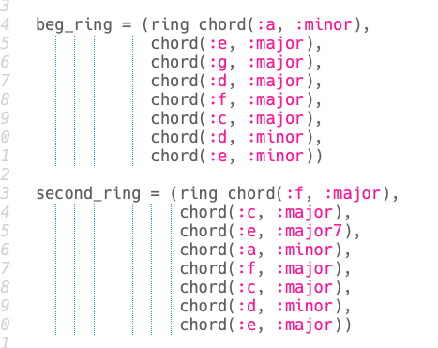
STARTING TO CODE
We wanted to use ring arrays to arrange our chords in the order it is in now, so that the function instructs Sonic Pi to keep looping around the same notes in the list each time.
We named our first ring array: beg_ring (beginner ring) and our second chord progression ring array: second_ring.
This will be useful later when it is called in our other functions, so we don’t have to write our chords multiple times.

Slide 23
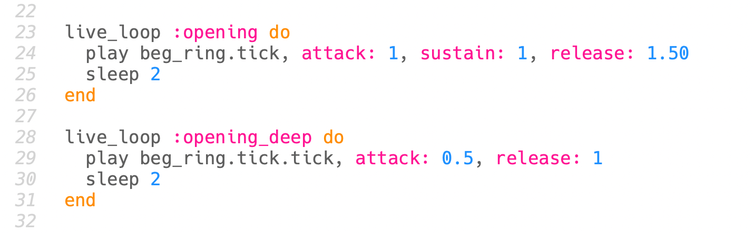
STARTING TO CODE
We used the live_loop function so that we could update the code whilst it is playing and click ‘Play’ again without stopping the current song to hear the changes.
The ‘play’ function allowed us to play the beg_ring chord progression, and added the .tick to be used as a counter (like a beat tracker) to “tick through the rings” and give us control over when a beat occurs.
We utilized the sustain and release utilities to help add depth and character to mature the musical compositions tone value.
Name of function
Incremented twice

Slide 24
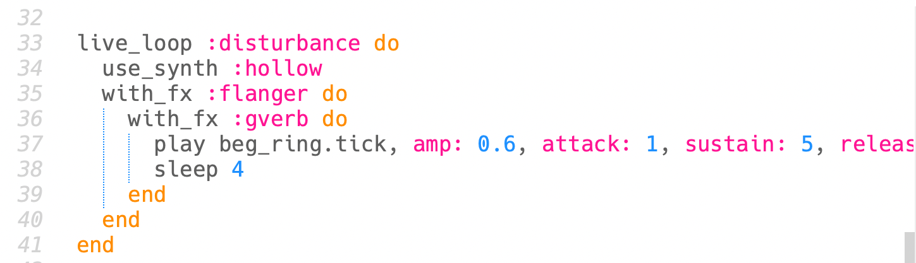
STARTING TO CODE
We used the use_synth :hollow function which changes the synthesiser for the notes played in that block (beg_ring chord). It gives it a more “hollow” sound as the name implies.
We used the fx flanger and gverb as well. Giving it a more robust and dramatic effect.
We changed the amplitude to be quieter from the previous chord progressions.

Slide 25
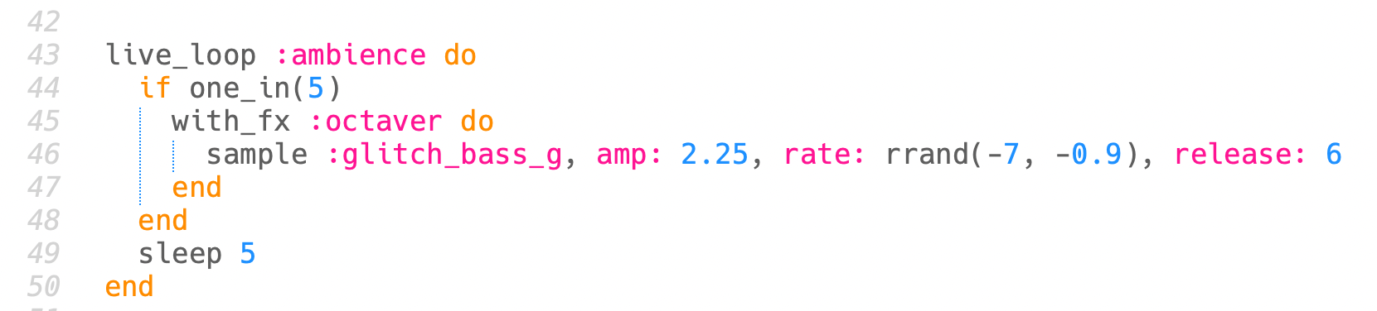
STARTING TO CODE
We used a simple one_in function to optionally execute this line of code, so a probability of 1 in 5 in different intervals.
We used fx :octaver to give the sample a more techno sound
We used the rrand function to randomize the rate value (speed) of the note from a max of -7 to -0.9)

Slide 26
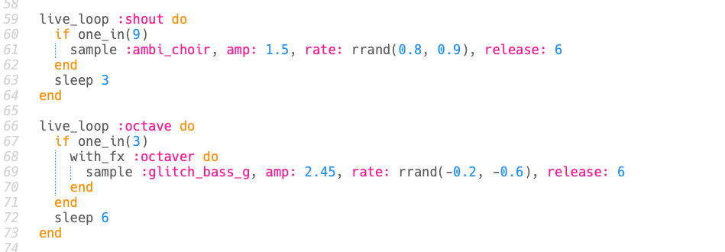
STARTING TO CODE
We basically used around the same functions as the previous block.
We used the sample ambi_choir and amplified it louder because we wanted a more gospel sound in the function called “shout”
We also amplified the sample glitch_bass_g to be louder to give it a richer sound at times.
The sleep functions are different numbers and we used randomization to give the song more dynamic.

Slide 27
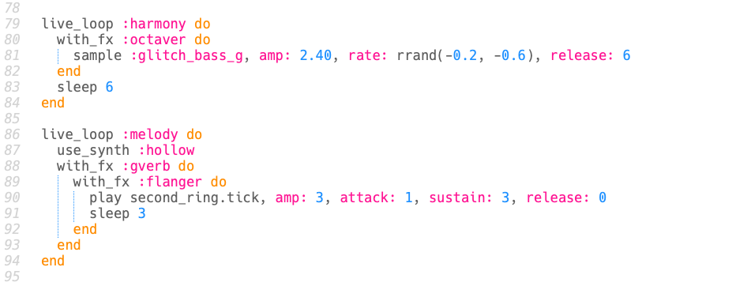
STARTING TO CODE
We changed the amplitude of the sample :glitch_bass_g and hollow to be amplified differently from the previous ones and to have different attack and release times to create a more cohesive and harmonic sound when put together.

Slide 28
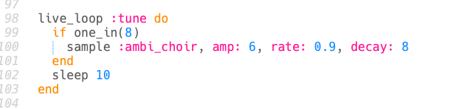
STARTING TO CODE
This is our last piece of code, where we took the sample : ambi_choir and tweaked its amplitude, rate, and decay to add a different dynamic to the song but with cohesion and rhythm.

Slide 29
PRESENTING:
HARMONIC CHAOS
COMPOSED BY: TEAM RHYTHM

Slide 30

COMPOSED BY: TEAM RHYTHM

Slide 31
Sources:
https://github.com/sonic-pi-net/sonic-pi/blob/dev/etc/doc/tutorial/A.11-beat-tracking.md
https://yorkdojo.github.io/worksheets/sonic-pi/doctor-who/
https://sonic-pi.net/tutorial.html#section-8-4
https://sonic-pi.net/
https://pianowithjonny.com/piano-lessons/the-most-beautiful-piano-chord-the-heaven-chord/

Slide 32
THE END

